Slide 1


Deep Convolutional Generative Adversarial Network
Haonan Peng
Linxiao Zhang
Notes:
Hi, my name is Haonan Peng, and my teammate is Linxiao Zhang.
Our project is about deep convolutional generative adversarial network. (next slide)

Slide 2
Introduction
Generative adversarial network (GAN) is deep learning model to capture the training data’s distribution to generate new data from that same distribution.
GANs are made up of two distinct models: a generator and a discriminator.
Deep convolutional GAN is a direct extension of GANs which uses convolutional and convolutional transpose layers in discriminator and generator.
Notes:
Generative adversarial network (GAN) is a deep learning model that captures the distribution of the training data so that it can generate new data from that same distribution.
GANs consist of two distinct models, a generator and a discriminator.
The discriminator takes input image and outputs the probability that it is a real image from training data rather than faked image from the generator.
The generator, of course, is to constantly spawn fake image.
Among the class of GANs, deep convolutional GAN is a direct extension of GANs, expect it explicitly implements convolutional and convolutional-transpose layer on discriminator and generator.

Slide 3
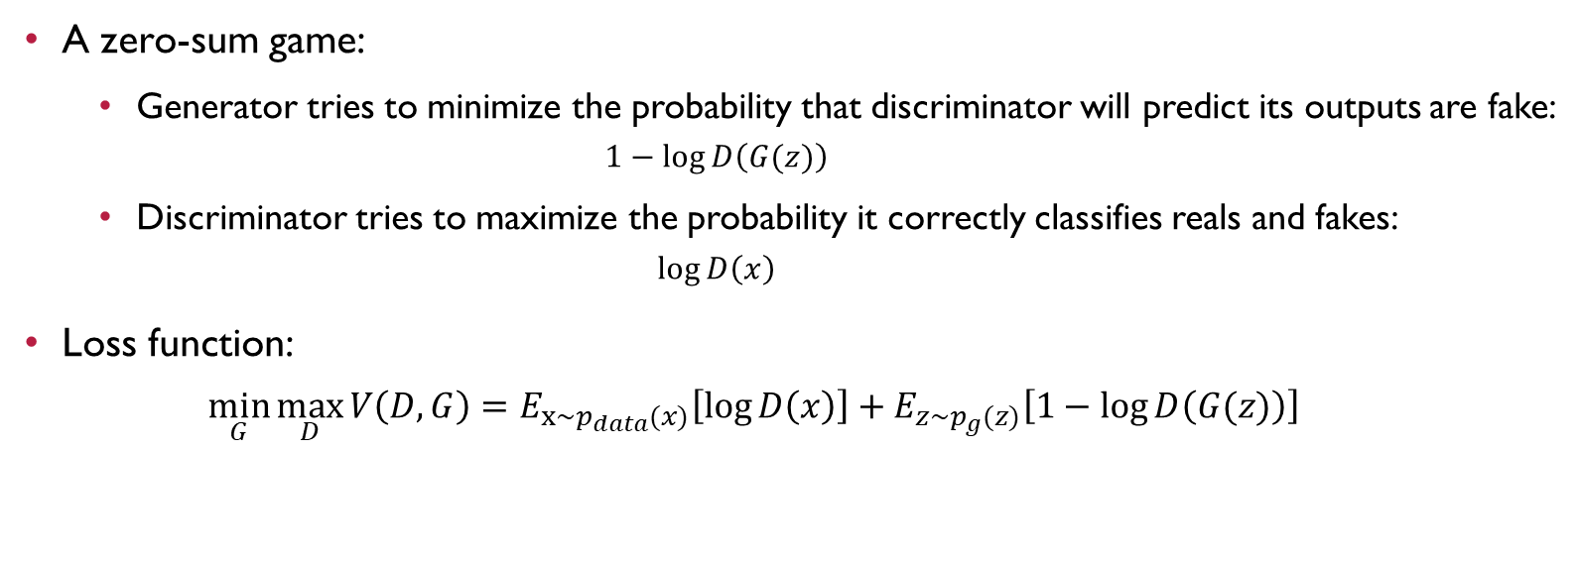
Methodology
A zero-sum game:
Generator tries to minimize the probability that discriminator will predict its outputs are fake:
$$1−\log{D\left(G(z)\right)}$$
Discriminator tries to maximize the probability it correctly classifies reals and fakes:
$$\log{D\left(x\right)}$$
Loss function:
$$\min_{G}{\max_{D}{V\left(D,G\right)}}=E_{x\sim p_{data}(x)}\left[\log{D\left(x\right)}\right]+E_{z\sim p_{g}(z)}\left[1−\log{D\left(G(z)\right)}\right]$$
Notes:
When we discuss about the functionality of GAN, in general, it can be simply described as a zero-sum minimax game.
The generator tries to minimize the probability that the discriminator will predict its outputs as fakes, while the discriminator tries to maximize the probability that it can correctly classify real or faked inputs.
For the mathematical notation, let x be data in image form, then D(x) is the probability output of discriminator which indicates if x is from the real training data instead of the generator.
As for the generator, we describe z as a latent space vector data generated by standard normal distribution, and G(z) is the output that mapping z from latent space to data space, which is the space of RBG image in our project.
The idea behind the mapping of G is to estimate the distribution of real training data p_{data} so that G can output images p_{g} from that distribution.
According to Goodfellow’s paper, taking these two probability in log base, then the loss function of our model can be described as below.

Slide 4
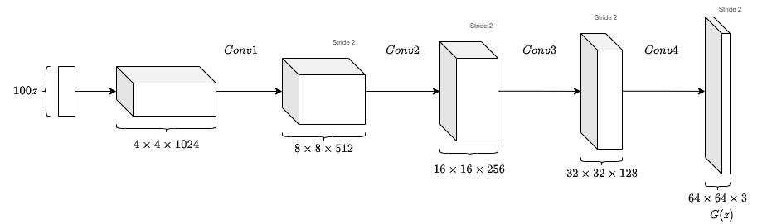
Methodology
Generator architecture:
Notes:
Let’s talk about the structure of generator.
Basically, the generator is composed of several stride-two-dimensional convolutional transpose layers, each of them is paired with a 2D batch normalization layer and a ReLU activation layer right after them.
Before generating the final output, it still need to pass a layer with {hyperbolic tangent} function to restrict the output in range from [-1,,1]. Here is the diagram of generator.
It should be mentioned that the bactnorm and ReLU activation layers in the structure of generator is to help the flow of gradient during training.
We will discuss it in detail in our experiment.

Slide 5
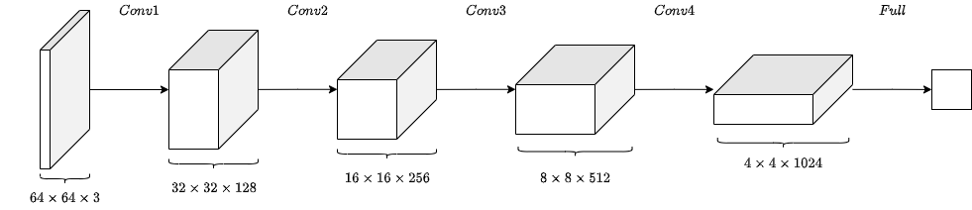
Methodology
Discriminator architecture
Notes:
As mentioned, the discriminator is a binary classification network.
The structure of it is close that of the generator but in a reversed form with slight difference.
So, the discriminator is composed of several blocks of 2D convolutional layer, batch normalization layer and leaky ReLU layer in series.
The output should pass a sigmoid layer as well in the final to restrict the probability of [0,1].
Again, the batchnorm and leaky ReLU layers are to keep the flow of gradient in a healthy condition during training. Below is the diagram of discriminator.

Slide 6
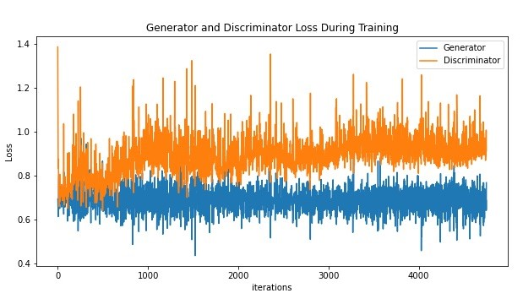
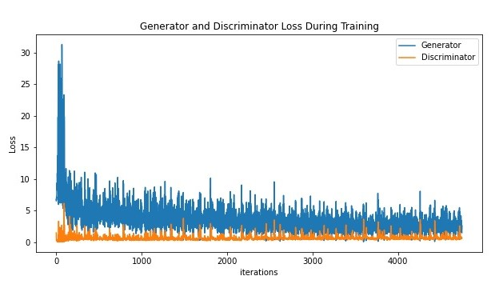
Experiment and results
Ablation experiment on implementation of batch normalization after convolutional and convolutional-transpose layers.
a) Training loss without batch norm
b) Training loss with batch norm
Notes:
At first, we run an ablation experiment on batch normalization after convolutional and convolutional-transpose layers.
Below are the training loss of the two models.
From these two figures we can see that the performance of the model with batchnorm is better, than that without batchnorm, since its loss is smaller.

Slide 7
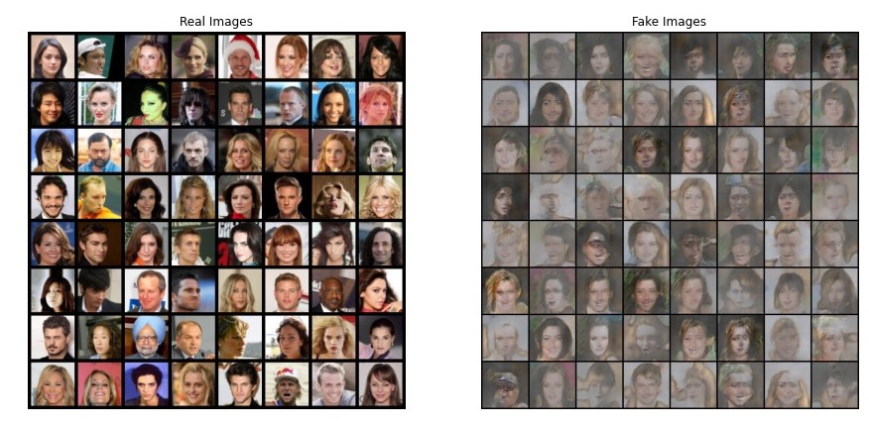
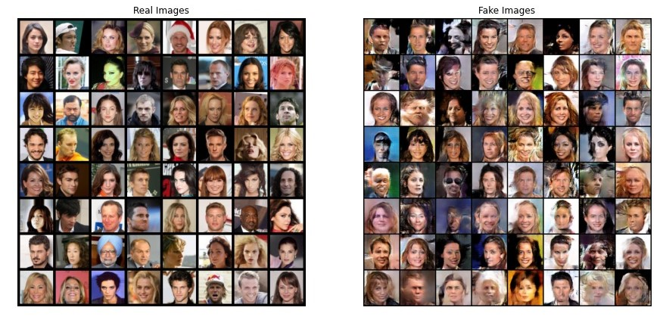
Experiment and results
Ablation experiment on implementation of batch normalization after convolutional-transpose layers.
a) Generated images without batch norm
b) Generated images with batch norm
Notes:
And here are the visualized results generated from the generators of two models.
We can see that the images are pale which are like overexposure. parameters or their initial values, regularize the model and reduce
The idea behind is that batch normalization can reduce the dependence of gradients on the scale of the the need for dropout, photometric distortions, local response normalization and other regularization techniques.

Slide 8
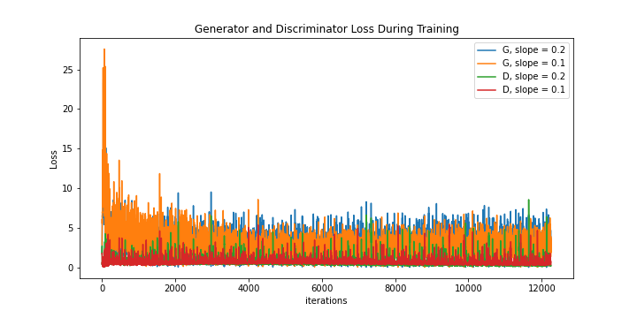
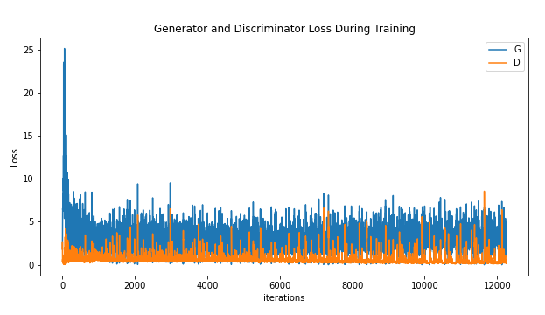
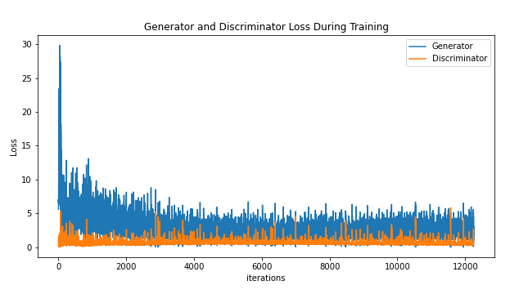
Experiment and results
Experiment on activation function of generator:
ReLU or Leaky ReLU;
manipulating slope of Leaky ReLU;
a) Training loss with ReLU
b) Training loss with leaky ReLU, slope = 0.2
c) Training loss with leaky ReLU, slopes = 0.1 and 0.2
Notes:
The second experiment we ran is to change the activation function of generator.
We replace the activation from ReLU to Leaky ReLU, and test the Leaky ReLU activations with different slopes, slope rate 0.1 and 0.2.
Here are the plots of training loss of the three models in experiment.
We can see that the leaky ReLu has better performance than basic ReLU.
And a slightly larger slope rate will make the model better as well.

Slide 9
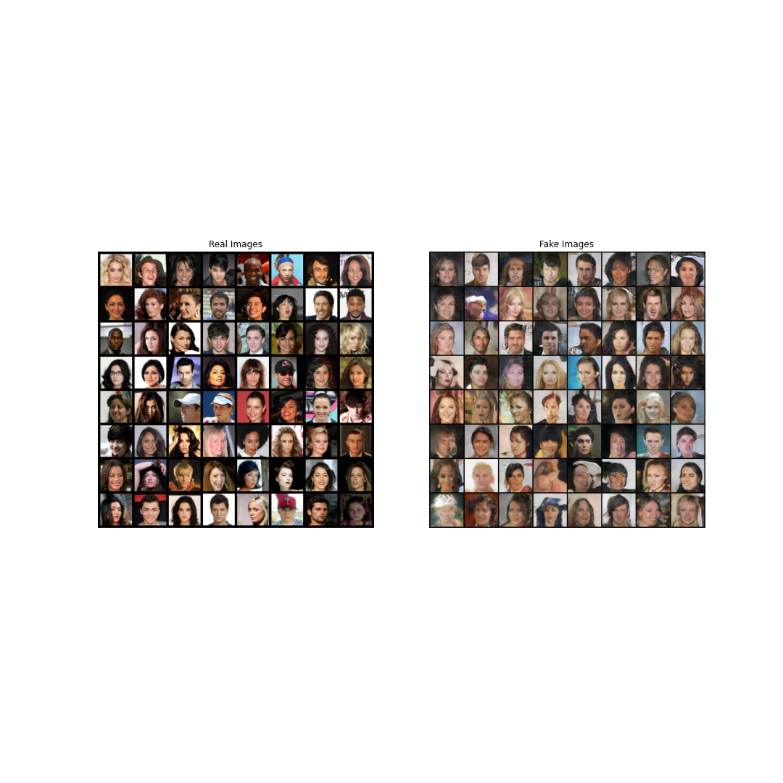
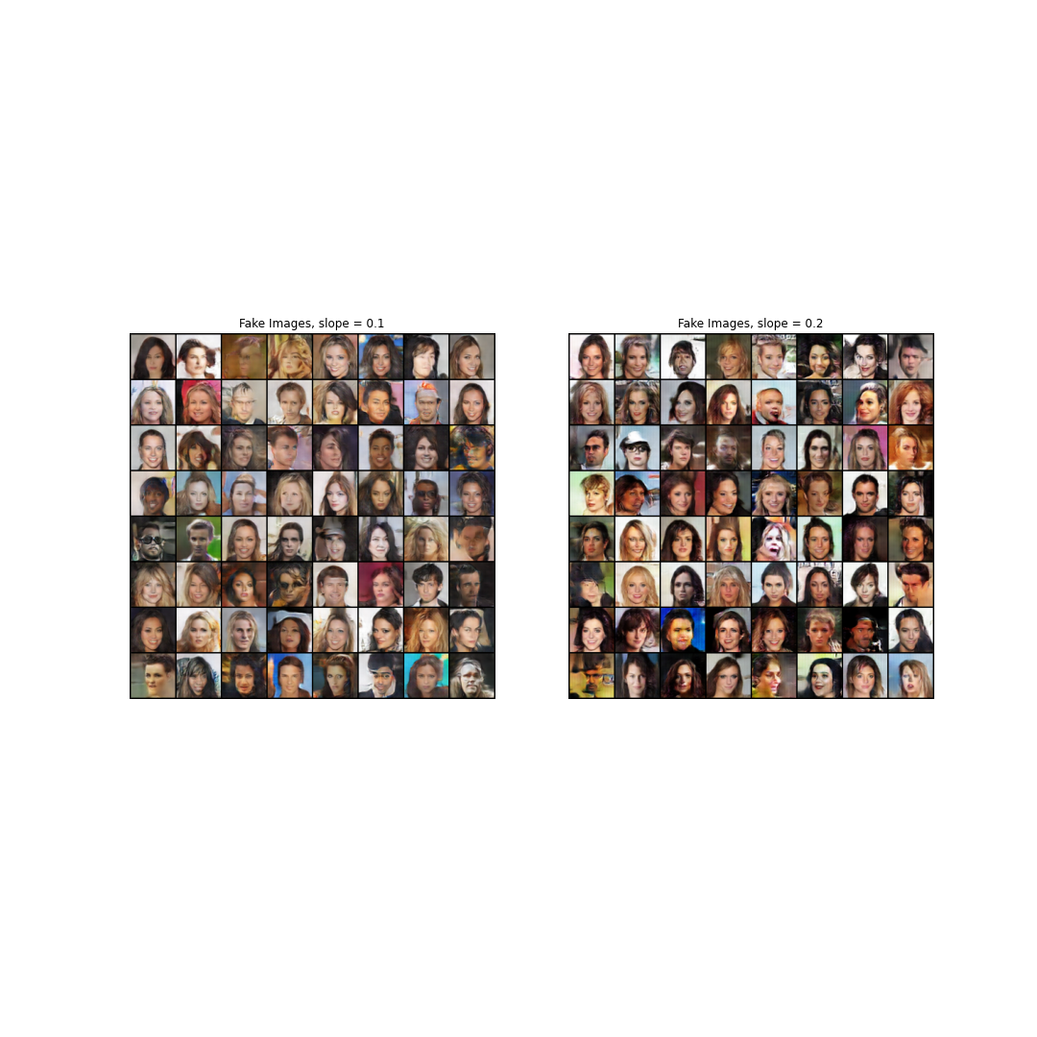
Experiment and results
Ablation experiment on activation function of generator:
ReLU or Leaky ReLU;
manipulating slope of Leaky ReLU;
a) Generated images with ReLU
b) Generated images with leaky ReLU in different slopes
Notes:
Here are some visualized results.
Since the results are generated after running 10 epochs, it should have more clear visual comparison after running more epochs.

Slide 10
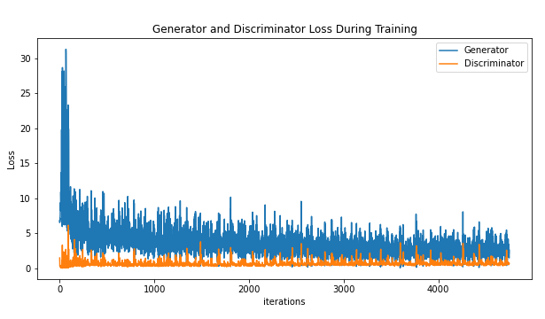
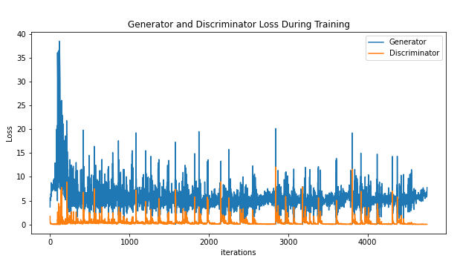
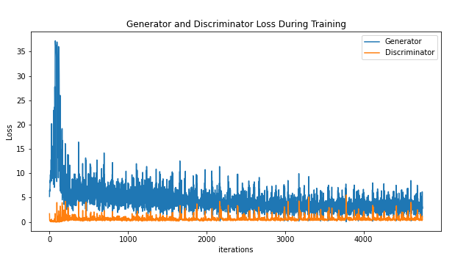
Experiment and results
Experiment on implementation of dropout:
with or without dropout;
different dropout rate;
a) Training loss without dropout
b) Training loss with dropout rate = 0.5
c) Training loss with dropout rate = 0.1
Notes:
At last, we introduced dropout into our models and manipulated adjust dropout rate in experiment.
From the plots of training loss of models shown below, the model without implementing dropout performs better.
If we insist on implementing dropout, the model with smaller dropout rate has better performance with no doubt.
We concluded that dropout is generally less effective when regularizing convolutional layers.
The reason is that convolutional layers have few parameters, so they initially require fewer regularization operations.
Besides, due to the spatial relationship of feature maps, activation values can become highly correlated, which makes Dropout ineffective.

Slide 11
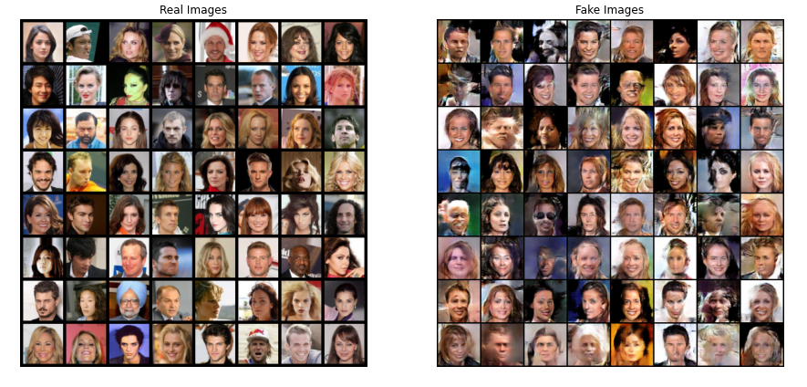
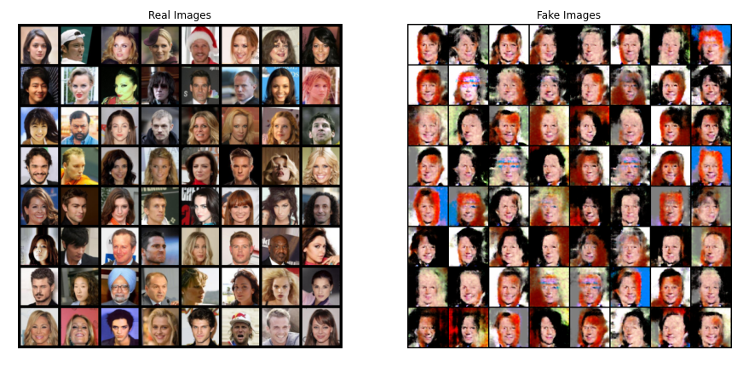
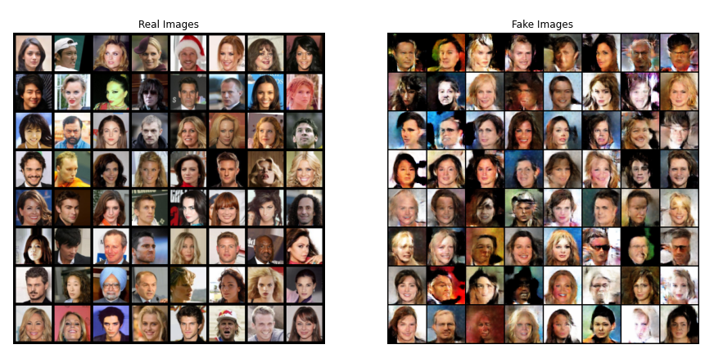
Experiment and results
Experiment on implementation of dropout:
with or without dropout;
different dropout rate;
a) Generated images without dropout
b) Generated images with dropout rate = 0.5
c) Generated images with dropout rate = 0.1
Notes:
Here are the visualized results from the models. They also prove our conclusion mentioned before.

Slide 12
Summary
Future exploration: Instance-Conditioned Generative Adversarial Networks (IC-GANs):
Inspired from kernel density estimation
Non-parametric approach for modeling distribution of complex datasets
Notes:
In our project, we reimplemented the deep convolutional generative adversarial network, while conducting a series of experiments on activation functions, batch normalization and dropout regularization.
As for the future step, we have some interests on Instance-Conditioned GAN, which is a non-parametric approach for modeling distribution of complex datasets.
Thank you.

Slide 13
Thank you!

